Slide 1


FOLDER SSECURITY

Slide 2
Objective:
To protect the folder contents by CLSID(Class ID) protection concept using java programming

Slide 3
MODULES:
Retrieving the folder.
Icons Selection(CLSID Selection)
Lock creation (lock.bat)
Unlock (unlock.bat)

Slide 4
Creating Folder
We should create the folder with some contents.

Slide 5
CLSID selection
From the list of CLSID’s we choose any one of them to
convert the folder functions into the corresponding CLSID function.

Slide 6
Create a lock.bat file
Batch file contains CLSID command that changes folder icon into our selected corresponding CLSID’s icon.

Slide 7
Create a unlock.bat
The original file contents in folder are restored while executing the unlock.bat file.

Slide 8


FOLDER SECURITY
Combination of both password locking & hiding concepts
Provide more security to important files
Quite hard to explore the locked files
Easy to implement the concept using java language.

Slide 9
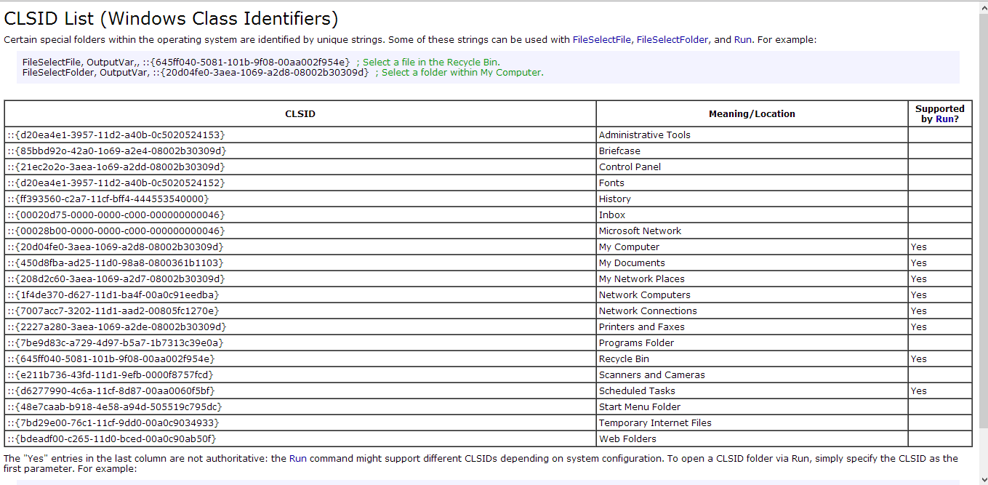
List of CLSID’s

Slide 10
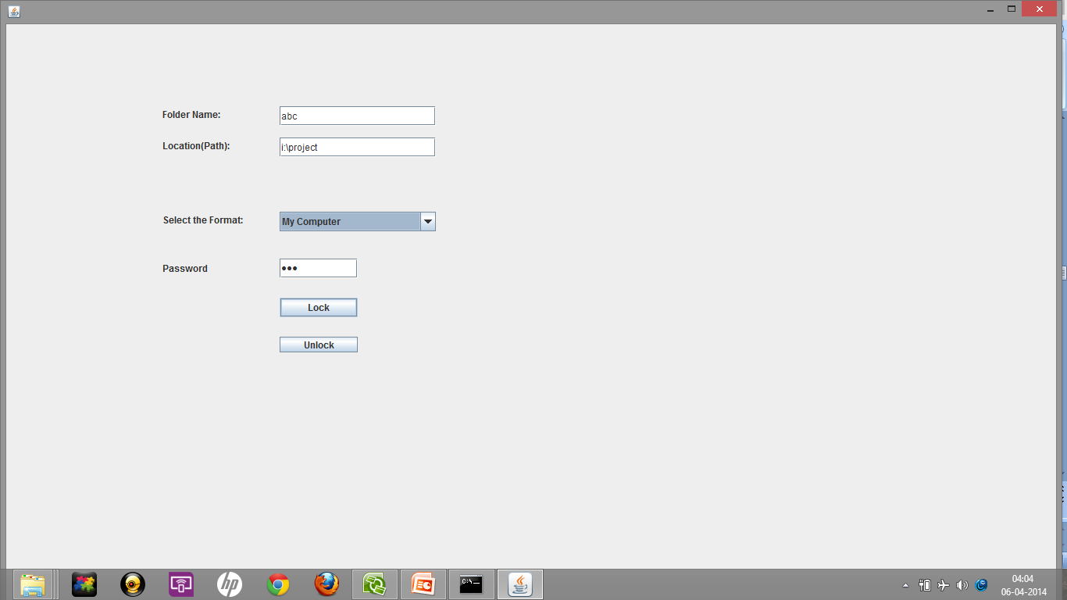
Front End:

Slide 11
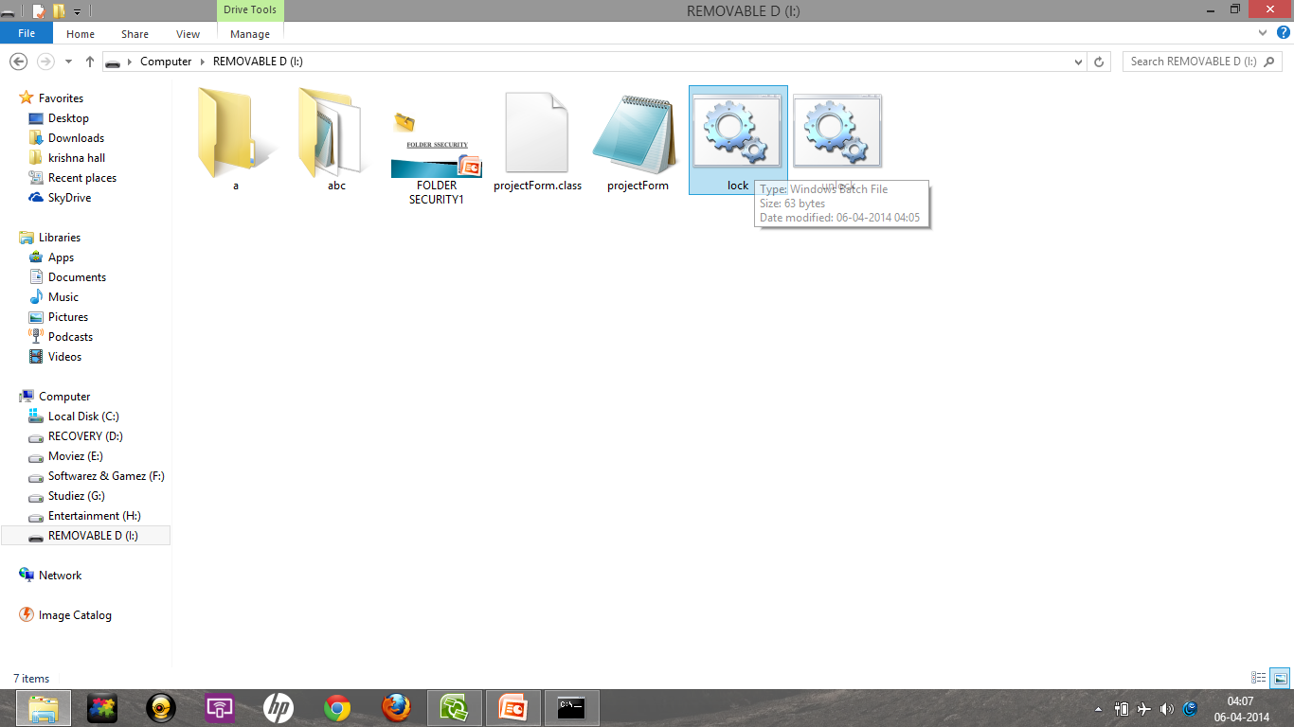
Going to hide the documents by double click the lock.bat

Slide 12
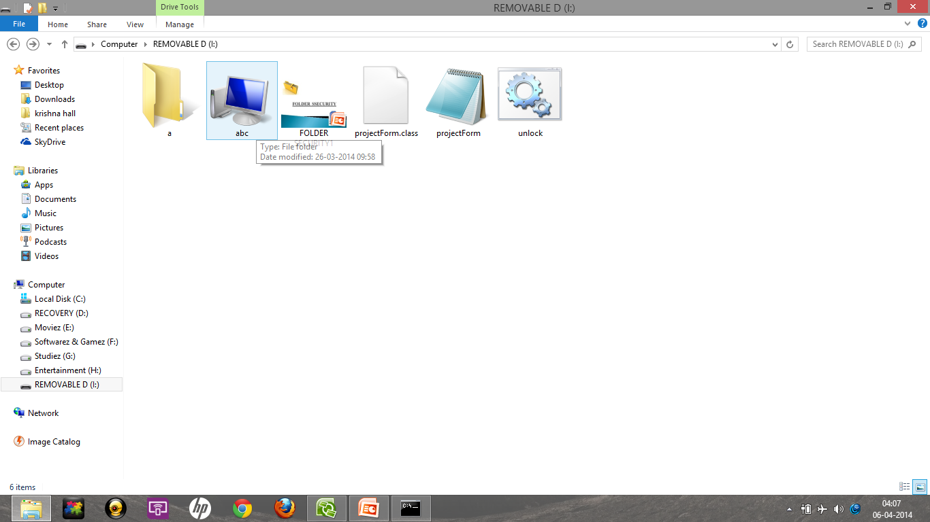
After run the batch command in lock.bat the folder is converted to my computer icon

Slide 13
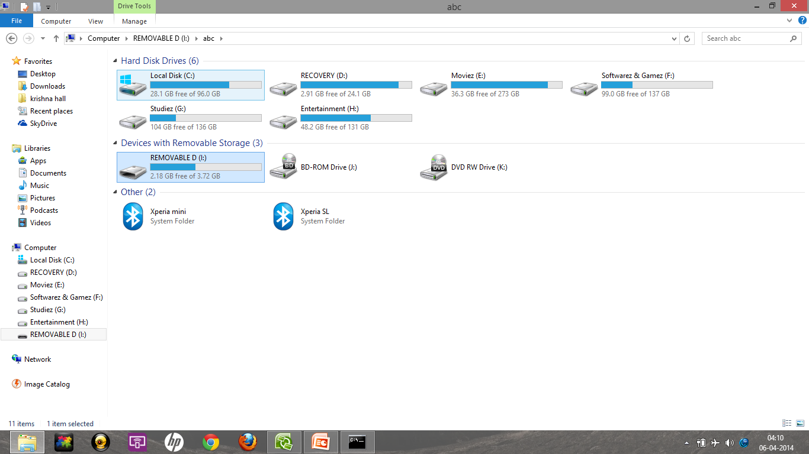
Modified appearance of secured folder (abc) by my computer CLSID

Slide 14
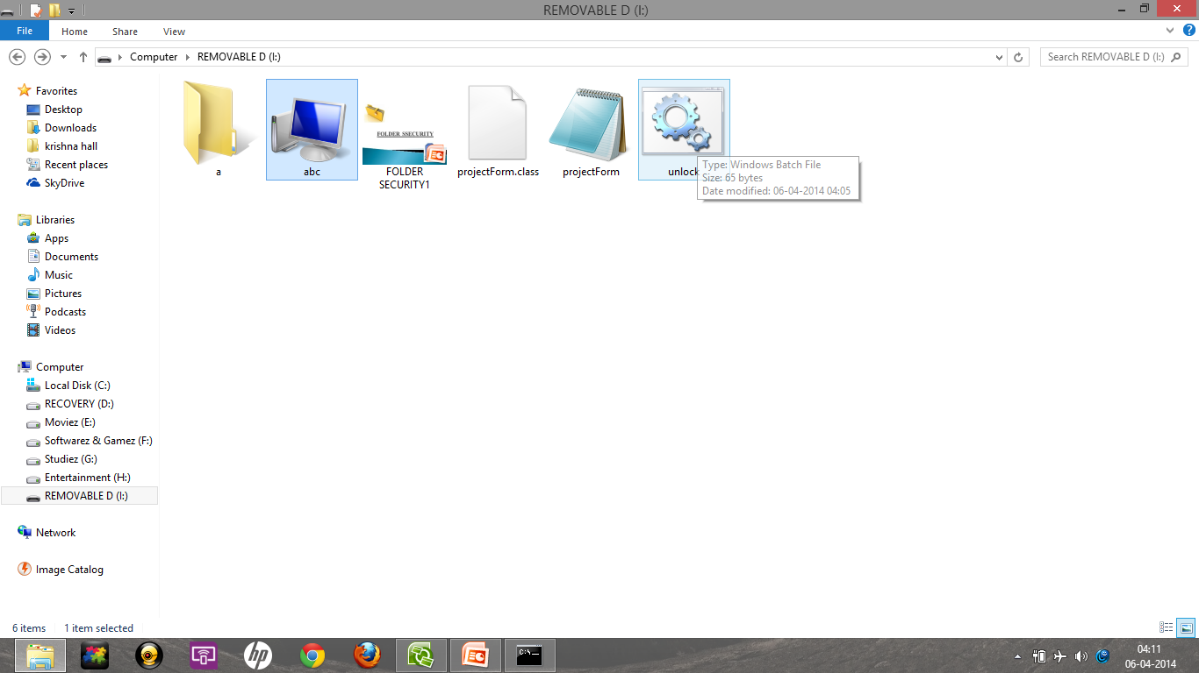
To unlock the folder,double click on unlock.bat batch file

Slide 15
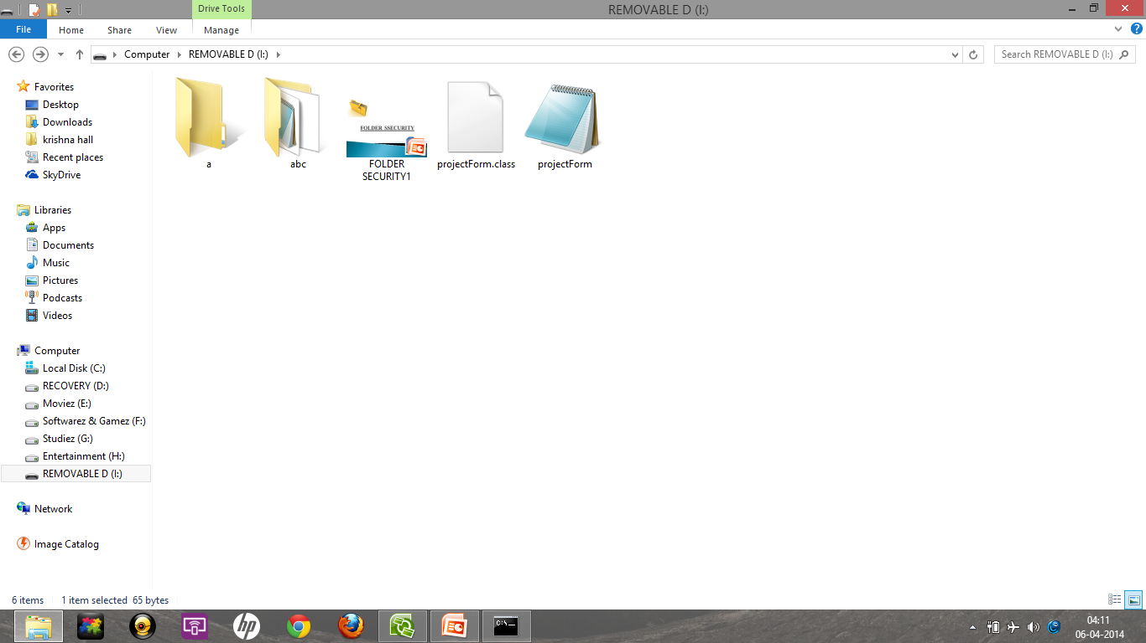
After unlock,regain the folder with original files

Slide 16
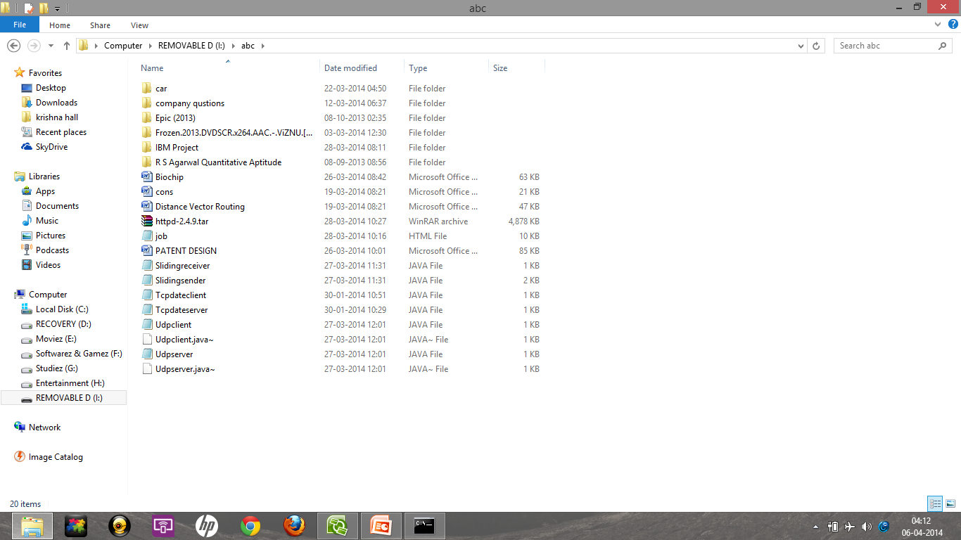
Now we get the original files back:

Slide 17
Advantages compared to other concepts:
Good programmers can simple to implement
Combination of file hiding & password locking concept enrich more security.
File hidden explorer can explore the hide files but there is no such choice to crack.
Source program is in java. hence not easy to execute the program because the executable file is protected with password.

Slide 18
Done by
B.Tech IT-B(3rd Year)
K . Venkatesh Kumar
M.Sathish Kumar
R V V Ragavendran

Slide 19
THE END

